Slide 1
LINE FOLLOWER ROBOT
-Systems Thinking
Team ABC (11)
Chirag Shameek Sahu (2019102006)
Konda Jayant Reddy (2019102010)
Abhishek Chawla (2019102020)
Pragya Singhal (2019112001)
Pranjali Pathre (2019112002)
Sasanka GRS (2019112017)

Slide 2
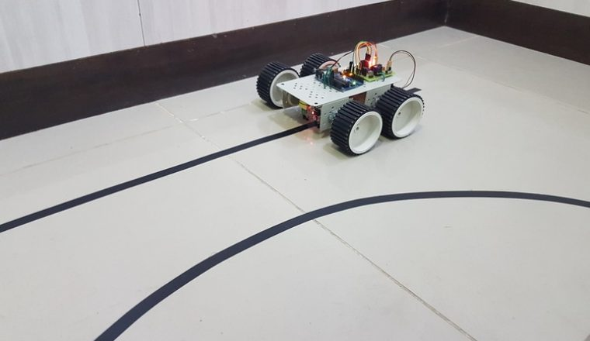
INTRODUCTION
The Line Follower Robot is one that follows a specific path indicated by a line (usually a black line on a light colored surface) with a particular width.
The robot will be able to detect a particular line and keep following it.
For special situations such as crossovers, the robot can have more than one path which can be followed, so we restrain from having crossovers in the lines.

Slide 3
PROJECT OVERVIEW
Our objective is to design robot that finds application in situations where transportation is essential with no human allowance. This robot is designed to be used in transportations in harsh conditions.
We aim at achieving smooth trajectories using different combinations of P, I, D controllers. We see that the most optimal set of controllers is obtained to be P, D because we are concerned about the present and upcoming values of the line sensors and not interested in remembering the past positions of the bot.
From a general ON-OFF circuitry, we obtain sharp changes in the trajectory of the bot which may lead to jerks and instability of the line tracking. This is solved by using PID controller.

Slide 4
PROPOSED CONTROLLER DESIGN
The proposed controller is a Proportional-plus-Integral -plus-Derivative (PID) digital controller. The PID controller would control the position of the robot with quick response time and minimize the overshoot.
The proportional part would determine the magnitude of turn required to correct the error sensed.
The integral part would improve the steady state error (proportional offset) which increases while the robot is not on the line.
The derivative part would measure the deviation from the path and minimize overshoot. It would reduce the oscillating effect about the line. The derivative control is used to provide anticipative action.

Slide 5
OBSERVATIONS WITH DIFFERENT CONTROLLERS : Using only P
P, the Proportional term is the error. It directly controls how to take the curves - if Kp is a small value, the robot will take the curves easier (it will go almost straight); if it is a large value it will take the curves suddenly (either it will oscillate on a straight line, or it will take the curve too tight and it will leave the track).
This introduces partial smoothness to the trajectory of the robot. It helps to reach a steady state value and it depends on present position of the robot.
We observe that the robot takes turns discontinuously, i.e., with breaks in between. By trial and error method we obtain the Kp value to be 0.01.

Slide 6
OBSERVATIONS WITH DIFFERENT CONTROLLERS : Using PD
The derivative term makes the calculation between the current error and the last error. When the robot suddenly hits a tight curve, this value will be high and will force the robot to take the required curve. At a Kd too small, this value might not take place. At a Kd too high, it can give errors to the whole program and the robot can oscillate, run very slowly or take very narrow curves that don't even exist.
This introduces complete smoothness to the trajectory of the robot. It helps to reach the steady state value and it depends on the future trajectory of the robot.
We observe that the robot moves more smoothly along the curve with continuous turns and no jerks. By trial and error method we obtain the Kd value as 1e-5.

Slide 7
OBSERVATIONS WITH DIFFERENT CONTROLLERS : Using PID
The integral term accumulates all errors. The integral term seeks to eliminate the residual error by adding a control effect due to the historic cumulative value of the error. In other words, it helps the robot stop oscillating. But at a Ki that is too high, it will do the opposite.
This introduces oscillations to the trajectory of the robot. It deviates from the steady state value as it depends on the memory, i.e., past trajectory of the robot.
We observe that the robot loses the line tracking ability as it oscillates in and out of the line which might cause the robot to completely deviate out of the line.

Slide 8
FINALISING K_{p}, K_{d} VALUES
Starting with K_{p}, we set K_{p} to a value of 1 and observe the robot. The goal is to get the robot to follow the line even if it is very wobbly. If the robot overshoots and loses the line, we reduce the K_{p} value.
On the other hand, if the robot cannot navigate a turn or seems sluggish, increase the K_{p} value. Here the robot lost the line and hence we reduced the value to get a final K_{p} = 0.01
After the robot is able to somewhat follow the line, we decide a value for K_{d} (skip K_{i} for the moment). Upon setting a high value the speed was too low and on decreasing the value, the robot started wobbling. Hence we managed to get an intermediate value with a considerable speed and no wobble i.e. K_{d} = 10^(-5)

Slide 9
EFFECTS OF PID CONSTANTS
Parameter | Rise Time | Overshoot | Settling Time | Steady State Error
Kp | Decrease | Increase | Small Change | Decrease
Ki | Decrease | Increase | Increase | Eliminate
Kd | Small Change | Decrease | Increase | No Change

Slide 10
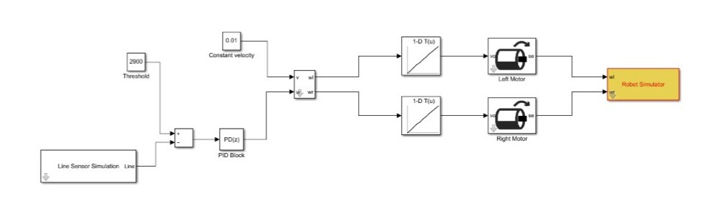
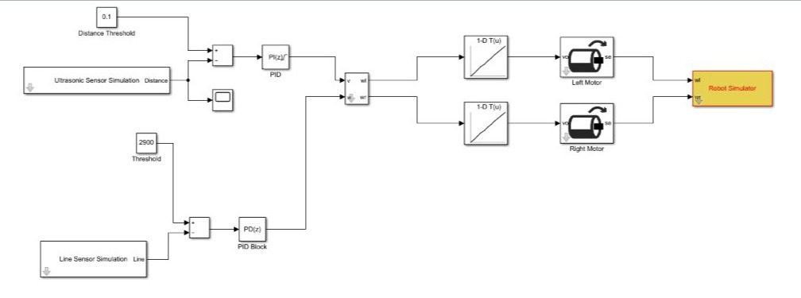

Slide 11

Thank you!

